Slide 1
SCRIPT ANALYSIS
This project introduces a comprehensive tool for analysis and evaluating programming code, focusing on metrics that provide insights into its structure, complexity, and quality.
NAME : ADHIVEL V
CLASS & SECTION : III-B
DEPARTMENT : BCA
ROLL NO. : 60702
REG NO. :2213141033052

Slide 2
Project Description
The Code Analysis Tool is a web-based application that provides comprehensive static code review, formatting, and analysis. Supports multiple programming languages. It helps developers understand code structure, complexity, and quality metrics through an intuitive interface. . This system serves developers, teams, and organizations by providing automated code formatting, quality assessment.

Slide 3
Purpose
Standardize code formatting across teams
Reduce manual code review time
Ensure coding standards compliance
Improve code quality and readability
Facilitate easier code maintenance

Slide 4
Proposed System
1
Code Input Methods
2
Analysis Capabilities
Direct code pasting
Syntax validation
File upload
Code metrics calculation
Drag and drop support
Complexity analysis
Structure identification
Pattern recognition
3
Result Presentation
Visual metrics display
Detailed breakdowns
Interactive components
Exportable reports

Slide 5
System Requirements
1. Hardware Requirements
1. Software Requirements
Server:
Server-side:
Processor: Multi-core CPU (2+ cores)
Python 3.8+
RAM: 4GB minimum
Flask Framework
Storage: 20GB minimum
Required Python packages:
Network: High-speed internet connection
Flask
Client:
Client-side:
Modern web browser
Modern web browser (Chrome, Firefox, Safari, Edge)
2GB RAM minimum
JavaScript enabled
Stable internet connection
Cookie support
Local storage access

Slide 6
System Specification
1. Hardware Specifications
2. Software Specifications
3.Performance Specifications
1.1 Server Requirements
2.1 Development Stack
3.1 Response Times
Processor: Multi-core CPU (2+ cores)
Frontend:
File Upload: < 5 seconds
RAM: 4GB minimum
HTML5/CSS3
Code Analysis: < 3 seconds
Storage: 256GB SSD or HDD
JavaScript (ES6+)
Code Formatting: < 2 seconds
Network: 1Gbps Ethernet
Monaco Editor
3.2 System Capacity
1.2 Client Requirements
Backend:
Concurrent Users: 1000+
Modern web browser (Chrome, Firefox, Safari, Edge)
Python 3.8+
File Size Limit: 10MB
Flask 2.0+
Request Rate: 100/minute per user
Minimum 4GB RAM
Redis
Total Storage: 500GB expandable
Stable internet connection (5Mbps+)
Development Tools:
Display resolution: 1280x720 minimum
Git
VS Code/PyCharm

Slide 7
Key Features: Output
1. Code Input Methods
2. Analysis Features
3. Formatting Capabilities
File Upload System
Style Checking
Code Structure
Support for multiple file formats
Language-specific style guides
Line length management
Batch processing capability
Custom rule configuration
Bracket placement
Direct Code Paste
Team standard enforcement
Comment alignment
Real-time syntax highlighting
Language auto-detection

Slide 8

Target Users: Empowering Developers
1
Individual Developers
Students, freelancers, and open-source contributors benefit from improved code quality and efficiency.
2
Development Teams
Software engineering teams, code reviewers, and project managers streamline workflows and enhance collaboration.
3
Educational Institutions
Programming instructors, students, and teaching assistants gain valuable insights and tools for learning and teaching.

Slide 9

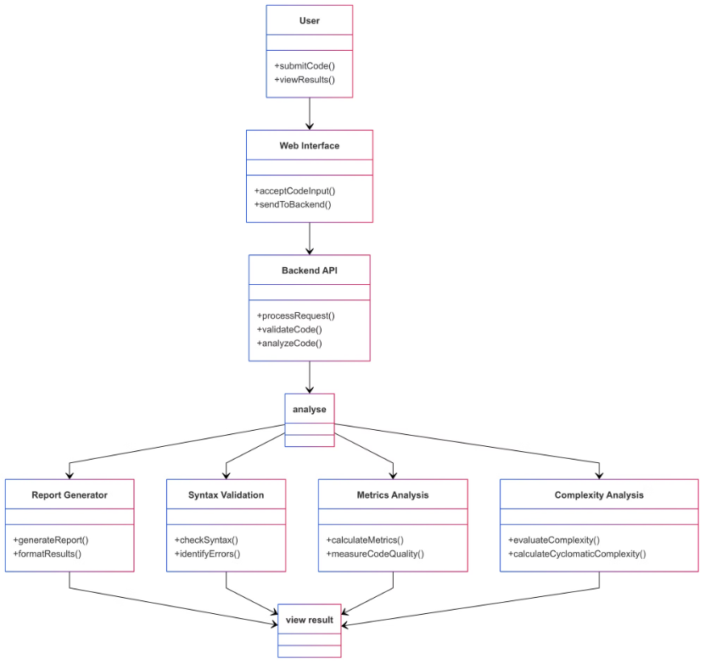
System Design Diagram

Slide 10
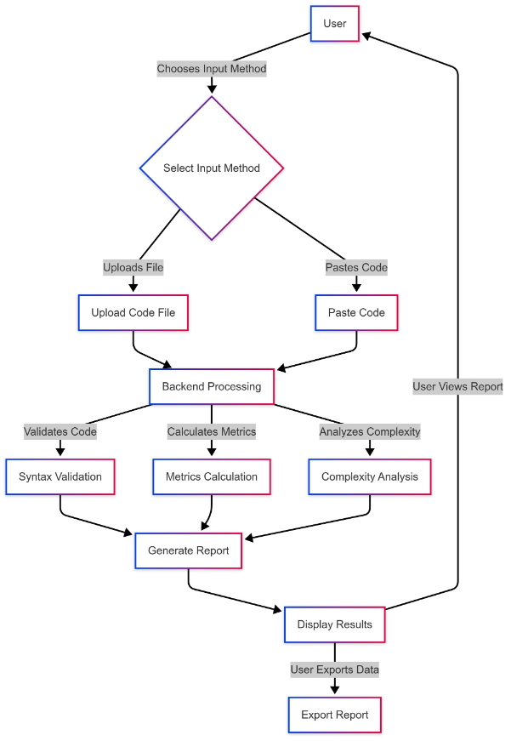
Data Flow Diagram (DFD)

Slide 11


Business Value: Efficiency & Quality
Efficiency Improvements
Reduces code review time by 50%, accelerates onboarding by 40%, and minimizes formatting issues by 30%.
Quality Assurance
Ensures consistent code style, reduces bug introduction, improves code maintainability, and promotes better documentation standards.

Slide 12




Business Value: Cost & Growth
Reduced Technical Debt
1
Minimizes code complexity and improves maintainability, reducing future development costs.
Lower Maintenance Costs
2
Enhances code quality and consistency, reducing the need for frequent fixes and updates.
Faster Development Cycles
3
Streamlines workflows, reduces errors, and improves collaboration, accelerating development timelines.
Improved Resource Allocation
4
Optimizes development processes, freeing up resources for innovation and strategic initiatives.

